Slide 1
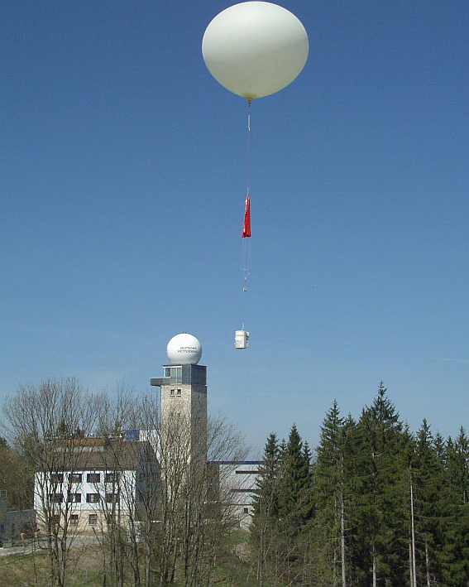
Detecting ozone layers from ozonesondes; Comparing layering to model
Ada Shaw
12/14/2017
https://www.dwd.de/EN/research/observing_atmosphere/composition_atmosphere/ozone/cont_nav/o3_measprog.html
Notes:
Today I will be discussing how I detected ozone layers from ozonesondes and how those compared to the high resolution geos 5 model

Slide 2
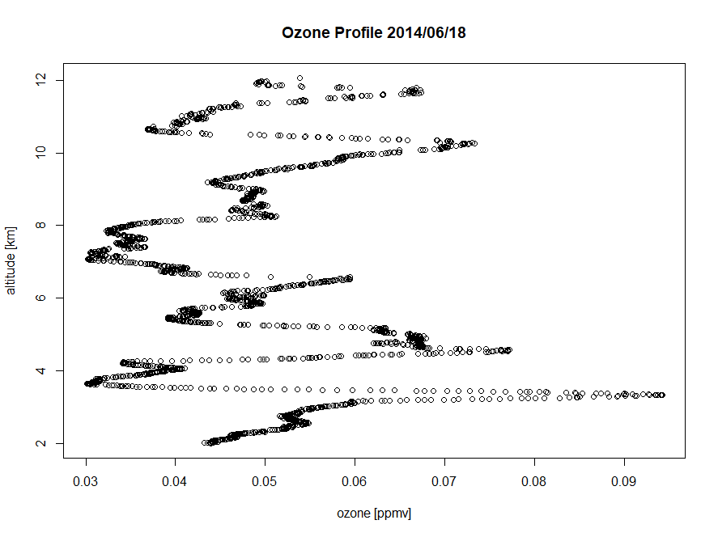
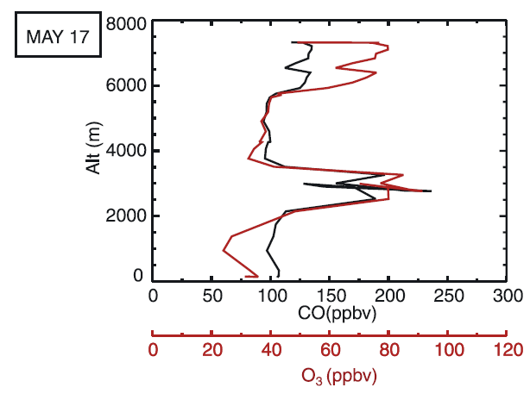
Ozone profiles
High ozone exceeding 80 ppbv or .08 ppmv
Hudman et al 2004 on ITCT 2002
Trinidad Head, NOAA
Notes:
The measured ozone profile is often not a smooth curve. It exhibits narrow layers of enhanced ozone concentration (positive laminae) and of depleted ozone (negative laminae). They reflect both evolutions of stratospheric intrusions and pollution plumes. Laminae are important because they reveal much stronger long-term trends than the ozone concentration itself and seem to be more sensitive to various factors.
Ozone laminae maxima at or above .08 ppmv are significant signs of pollution layers or stratospheric intrusion. Here we deal only with positive laminae.
I examine a year’s worth of Trinidad head ozonesondes and find the layering there.

Slide 3
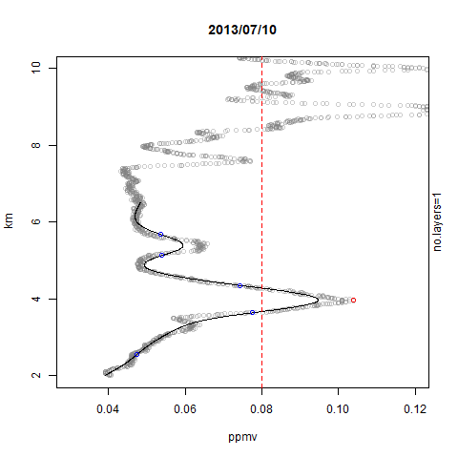
Layer Detection Algorithm
Defined Tropopause using temperature profile
Defined 2km as Planetary Boundary Layer
Set boundaries of Free Troposphere (FT)
Fit spline to ozone profile in FT (differentiable)
Find 2nd derivative
Define the concavity changes as widths of layer
Define the positive maxima as the lamina values
Positive lamina must be greater than 5 ppb from the width ozone values
Define lamina greater than .08 ppmv and between 0.3-3.5 km wide as significant
Notes:
I want to keep my measurement within the free troposphere, the region between the pbl and the tropopause.
I defined tropopause as the thermal tropopause as it would mark slowing in temperature decrease in response to the heat generated by the rapid photolysis and reformation of ozone. I want to focus on ozone lamina in the free troposphere defined as the region between the pbl and the tropopause
I fit a spline to the ozone profile because it is a differentiable, I don’t care much for the amplitude because I define the maxima using the raw data rather than the spline fit
I find the 2nd derivative to define the width of the layer and find the maxima contained within it.
I want the positive lamina to be greater than 5ppb from the width ozone values because I want to avoid noise caused by bumpy layers. (maybe draw on board)
I define the significant lamina to be greater than .08 ppmv because I want the significant lamina. Sometimes you have tropical air coming into the troposphere and it causes a shift in the profile (point that out in the video on the next slide)
I want the lamina to be wider than .03-3.5 km because I want to filter out noise while not including background structures of the profile. The non significant oscillations in the ozone profile are insignificant because they can be caused by gravity waves.

Slide 4
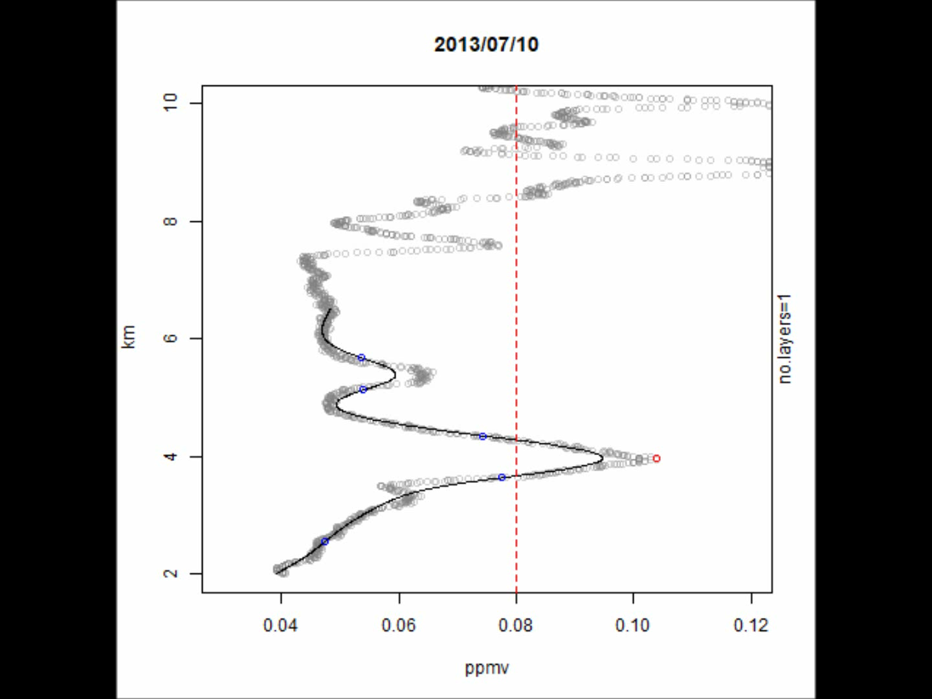
Layer Detection
Notes:
I did this for the rest of the data from july 2013-June 2014. Again the red dot is the layer and the black line is the spline fit.
Video: Check on 07/17,08/06- tropical air coming in

Slide 5
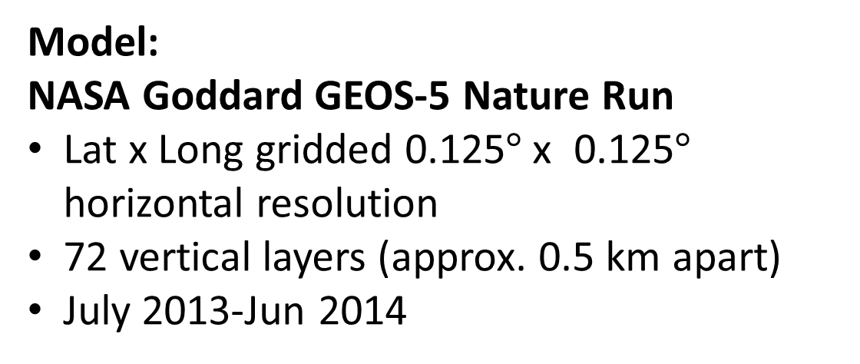
Modeling versus Observations
Model:
NASA Goddard GEOS-5 Nature Run
Lat x Long gridded 0.125$°$x 0.125$°$ horizontal resolution
72 vertical layers (approx. 0.5 km apart)
July 2013-Jun 2014
Notes:
We want to see if we can identify layers in our model. I used the NASA Goddard GEOS-5 Nature run which is a .125x.125 (approx. 10km by 10km) horizontal resolution
It has 72 vertical layers which span from the surface to the 80km above it, At the free troposphere, these layers are around .5 km apart. This nature run data spanned from July 2013- august 2014, the same range at which the observation data was chosen for.

Slide 6
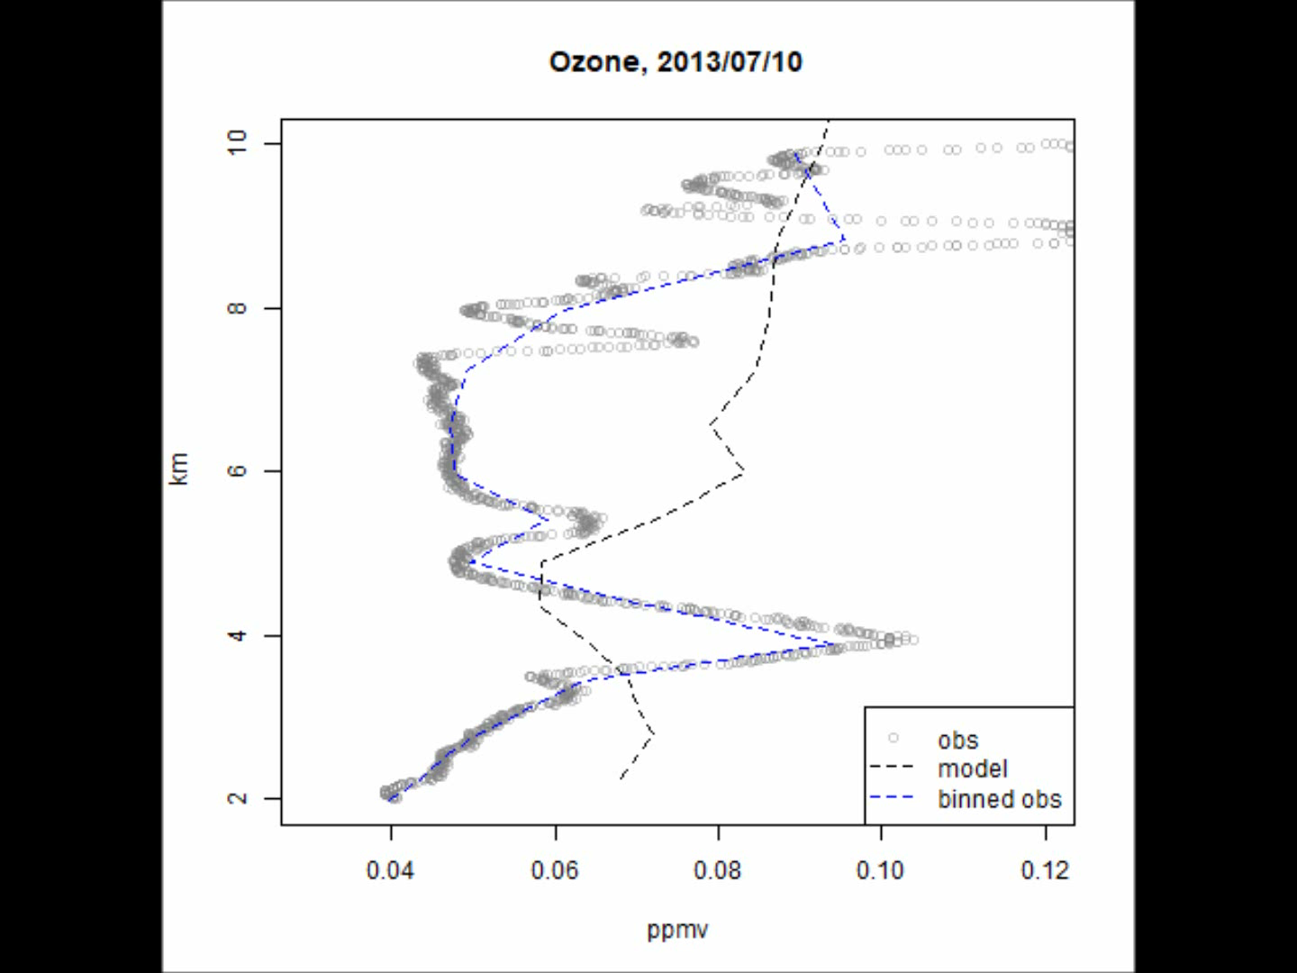
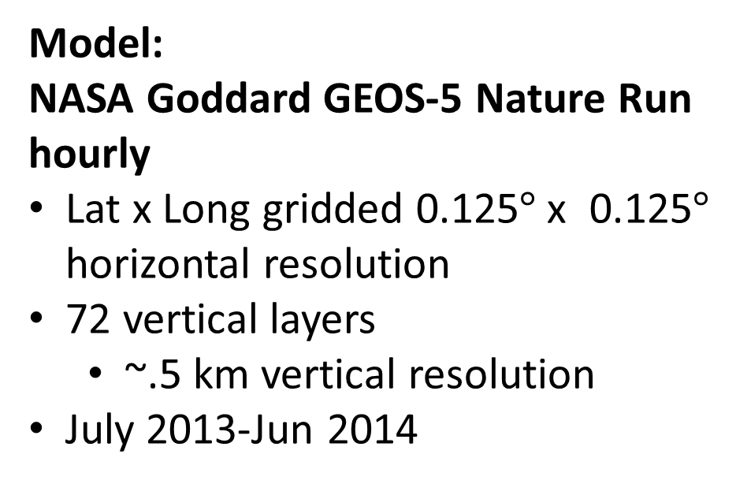
Modeling versus Observations
Model:
NASA Goddard GEOS-5 Nature Run
hourly
Lat x Long gridded 0.125$°$x 0.125$°$ horizontal resolution
72 vertical layers
~.5 km vertical resolution
July 2013-Jun 2014
Notes:
The model is completely different to the ozonesonde on some days and is generally really very poor. The dots are the observation. The blue line is the observation at model resolution and the black line is the model resolution. It does fit well at the whole scale of 0 to 30 km (ozonesonde height) because stratospheric ozone is around 6-8 ppm

Slide 7
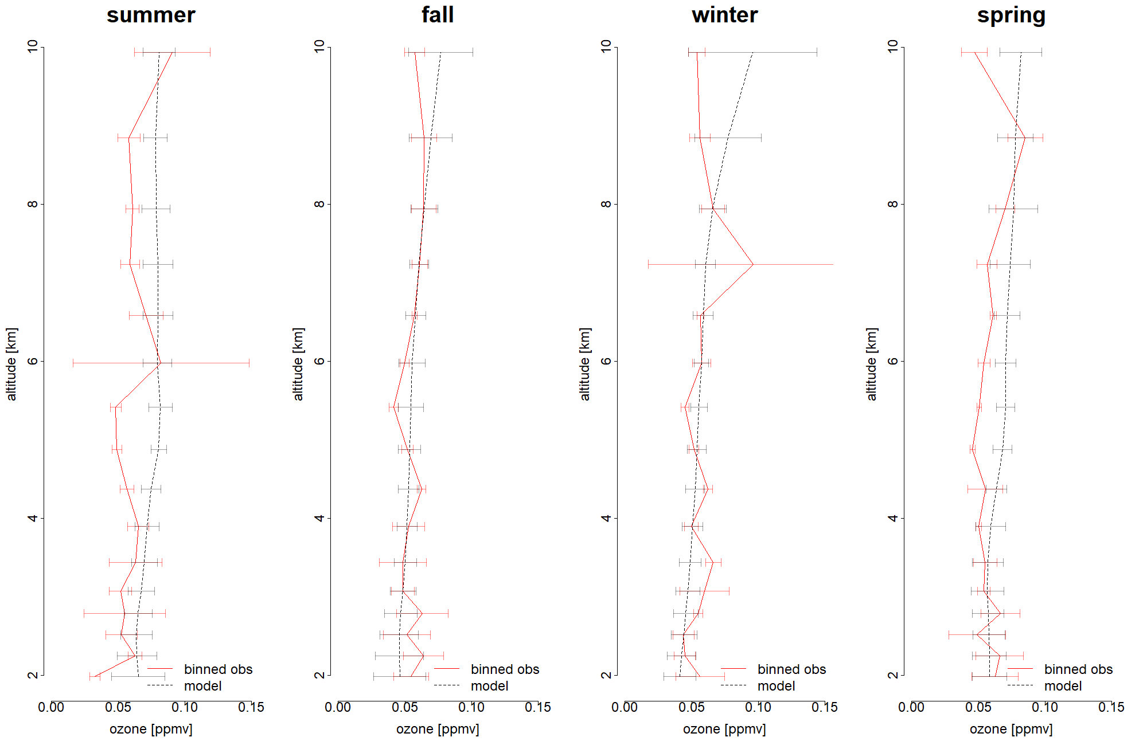
Modeling versus Observations
Notes:
The model completely disregards the data on some days and is generally really poor. We find that it could potentially be good for showing the seasonal however it is seen to be consistently flat (as seen by the small standard deviations) compared to observation.
The flatness in the modeled layers can be attributed to numerical diffusion and spatial averaging on the model grid. I’ll be first discussing numerical diffusion.

Slide 8
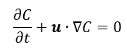
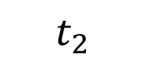
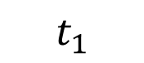
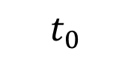
Numerical Diffusion/Dissipation
Pure advection: max mixing ratio preserved and plume shape maintained
C
$$t_{0}$$
$$t_{1}$$
$$t_{2}$$
x
Eulerian chemical transport models (CTMs) have difficulty reproducing these layered structures due to numerical plume dissipation.
Notes:
A pollution plume or stratospheric intrusion will be expressed as layers in the vertical ozone profile. Numerical diffusion causes the premature breakdown of these plumes, resulting in a flat profile.
Solving the advection equation using a finite difference numerical scheme introduces error that is precisely analogous to physical diffusion
In the absence of molecular diffusion (i.e. the error), the continuity equation prescribes that the chemical concentration within the plume should remain constant in time even with stretching of the plume. However, numerical diffusion in the advection algorithm causes the plume to decay rapidly when stretched because it causes the plume to be poorly resolved
We can see this in the diagram above, under pure advection, if the plume is shifted to the right, it should maintain its shape, however numerica diffusion at sharp concentration gradients causes a decrease in the maximum mixing ratio

Slide 9
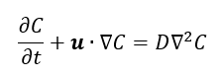
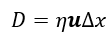
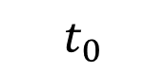
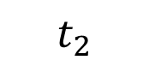
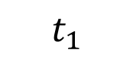
Numerical Diffusion/Dissipation
Numerical diffusion: Maximum mixing ratio isn’t conserved
C
$$t_{0}$$
$$t_{1}$$
Finite Differences Scheme:
(first order example)
$$t_{2}$$
y
higher order schemes cannot resolve sharp gradients
Notes:
There is a loss of mixing ratio under numerical diffusion
GEOS-5 is a third order piecewise parabolic scheme. These higher higher order finite difference schemes are more accurate but they still break down at sharp gradients/dicontinuities (flux limiter to prevent spurious oscillations).

Slide 10
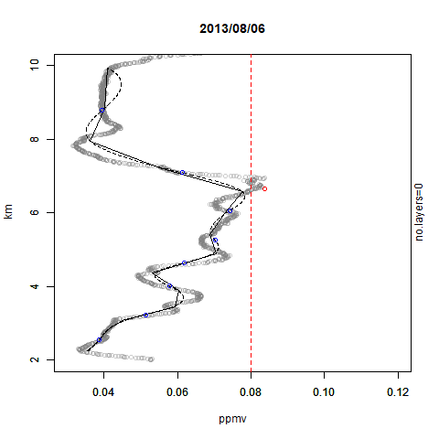
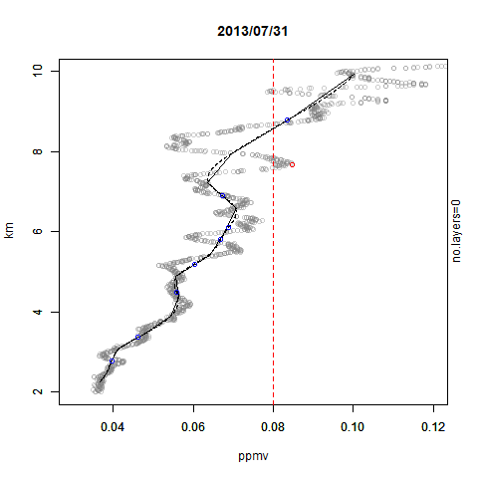
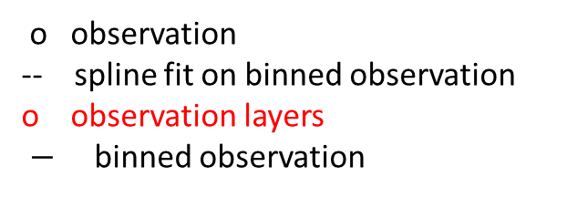
Spatial Averaging
o observation
-- spline fit on binned observation
o observation layers
$−$ binned observation
Notes:
The issue with the model isn’t just the numerical diffusion with respect to the poor resolution but also the spatial averaging leading to loss of information. Here we see that observation binned to model resolution cannot capture the layers detected because the vertical resolution is just too poor. Two separate layers identified in august and july are lost to spatial averaging. The red dot is the layer identified via observation, the number of layers in both are 0 according to the observation at model resolution. This is seen in other graphs as well

Slide 11
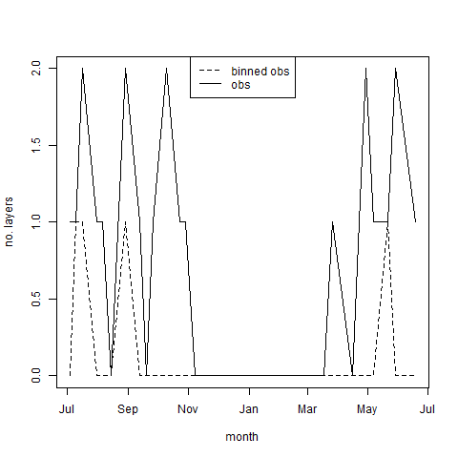
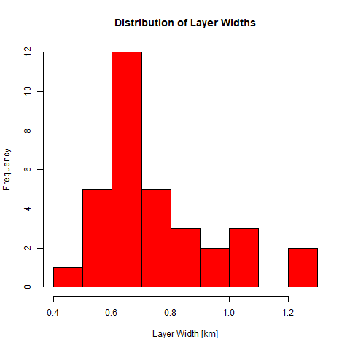
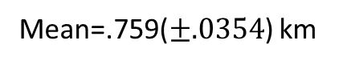
Spatial Averaging
Mean=.759($±.0354$) km
Notes:
This graph further shows the loss of layers at model resolution, we aren’t able to get 2 layers and furthermore the days which we have layers are reduced because of the reasons shown in the last slide. Smaller layers are lost. A distribution of layer widths is shown here with the peak of the detected layers are at 0.6 to 0.7 km with a mean of .759 km and a bootstrapped standard error of .0354 with 1000 replications. With a spatial resolution of 0.5 km it is difficult to capture such layers. The .5km vertical resolution will invariably smooth those out.
This shows how spatial averaging and numerical diffusion by the advection scheme are intertwined to reduce the accuracy of our models’ ability to show significant layers.
This has ramifications in air quality predictions stemming from stratospheric intrusions or ozone layers traveling long distances in the free troposphere.

Slide 12
Summary + next steps
Identified layers with significant ozone maxima
Look at water vapor mixing ratio to identify stratospheric intrusions
Found that model doesn’t reproduce such layering and this is due to spatial averaging and numerical diffusion
Observations at model resolution loses layering due to spatial averaging
histogram of layer widths could help us decide which vertical resolution could capture these layers
Notes:
I identified layers with significant ozone maxima. I can further analyze these layers by examining whether they are pollution or stratospheric intrusions by looking at the water mixing ratio. Stratospheric intrusions are rather dry.
By examining the NASA GEOS-5 nature run I found that high resolution models still cannot reproduce the layering due to spatial averaging and numerical diffusion. The observations at model resolution loses layering due to spatial averaging. A histogram of layer widths could help us decide which vertical resolution could capture these layers.

Slide 13
Reference
Hudman, R. C., et al. "Ozone production in transpacific Asian pollution plumes and implications for ozone air quality in California." Journal of Geophysical Research: Atmospheres109.D23 (2004).
Eastham, Sebastian D., and Daniel J. Jacob. "Limits on the ability of global Eulerian models to resolve intercontinental transport of chemical plumes." Atmospheric Chemistry and Physics 17.4 (2017): 2543-2553.
Heald, Colette L., et al. "Asian outflow and trans‐Pacific transport of carbon monoxide and ozone pollution: An integrated satellite, aircraft, and model perspective." Journal of Geophysical Research: Atmospheres 108.D24 (2003).
Krizan, P., and J. Lastovicka. "Trends in positive and negative ozone laminae in the Northern Hemisphere." Journal of Geophysical Research: Atmospheres 110.D10 (2005).
Thouret, Valérie, et al. "General characteristics of tropospheric trace constituent layers observed in the MOZAIC program." Journal of Geophysical Research: Atmospheres 105.D13 (2000): 17379-17392.

